Slide 1
GT Bookswap Group 44: BongBong Bongsu Kim Gu Young Chung Jaemin Baek Jongyeon Kim Sungpil Yoo

Slide 2
Customer: GT Students
Facebook GT book Swap
- Lack of search options
- Structural Problem
Our product
- Allows users a variety of search options
- Visible and well-organized web-app

Slide 3
Implemented Features
DB
(LinQ)
Model
(Google API / C#)
Responsive Web Design
IIS
Server
Controller
(.NET / C#)
View
(Razor / Bootstrap)

Slide 4
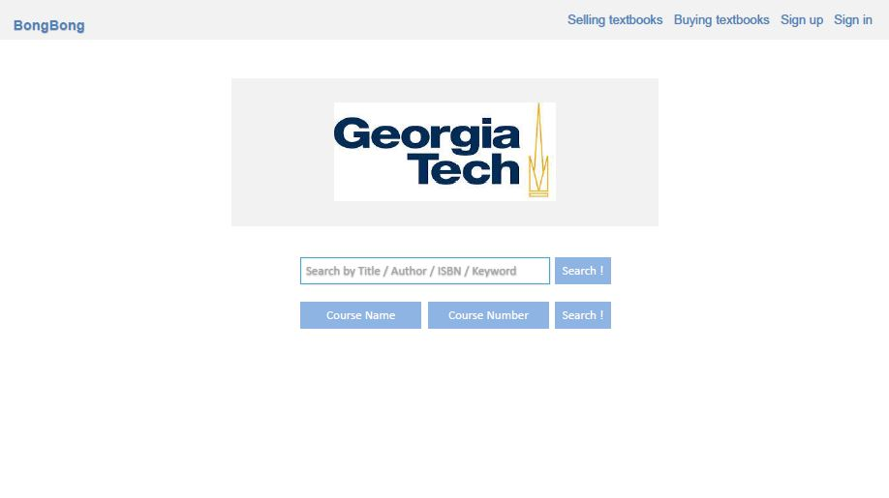
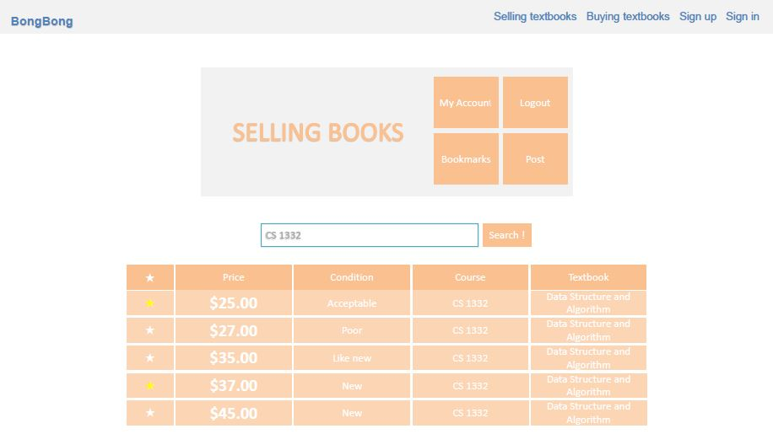
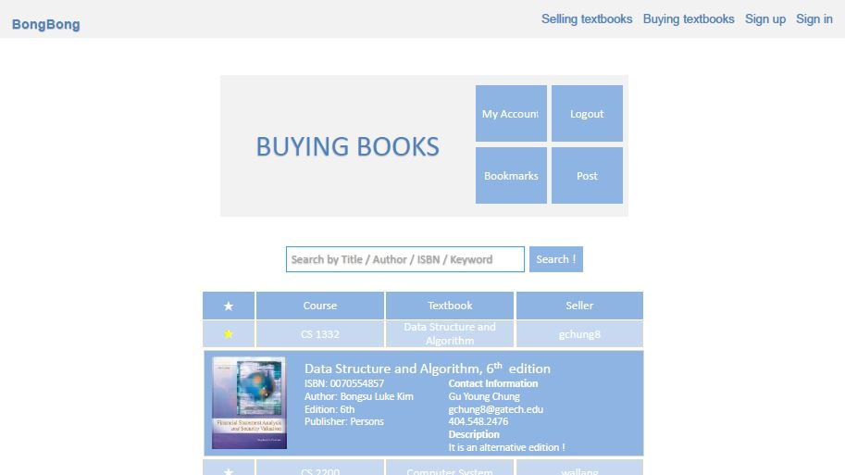
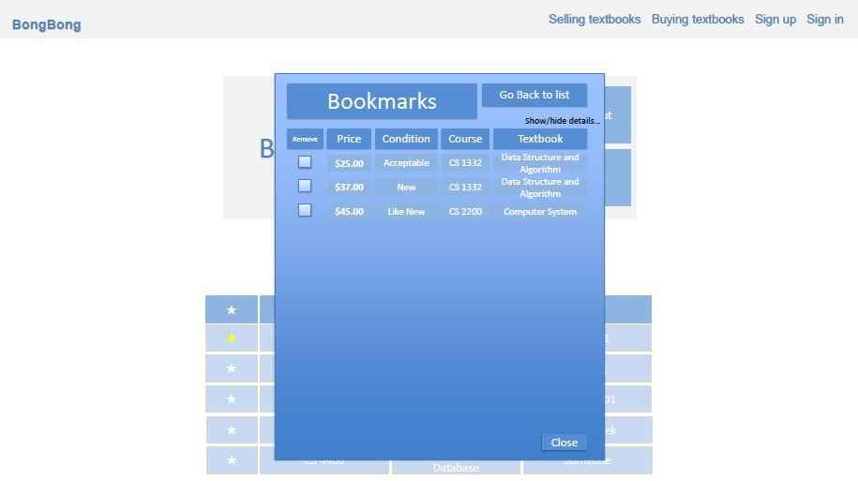
Notes:
I am going explain our previous versions what we did before current version. This is our mockup pages which we made before we implement actual coding. At the first time we consider some essential features such as searching by course and bookmarks, so we tried to follow out mockup as possible as we can.

Slide 5
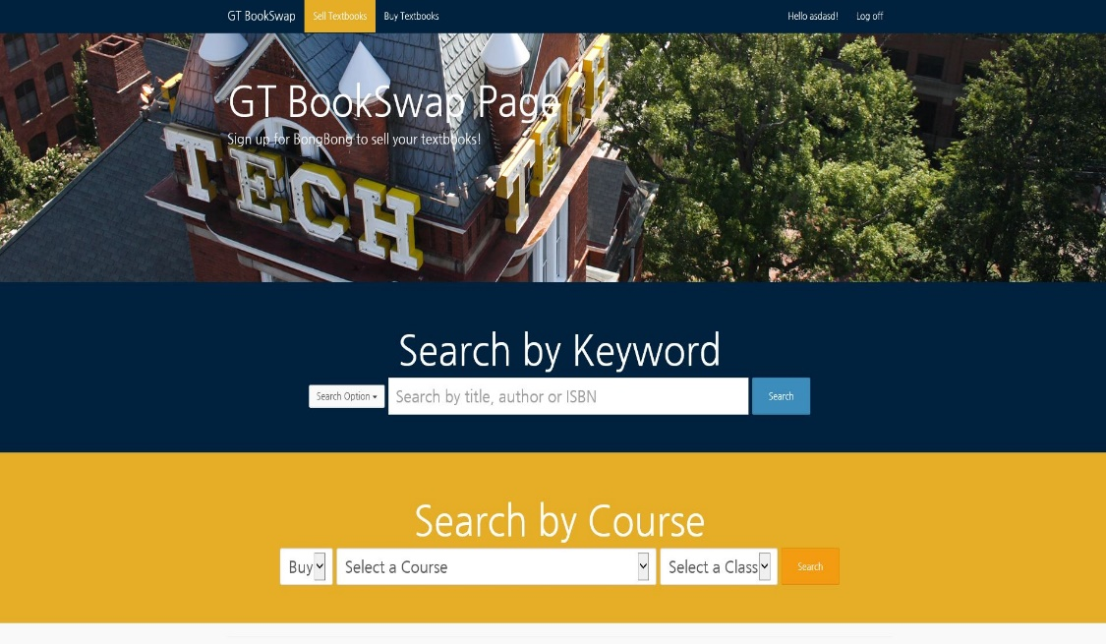
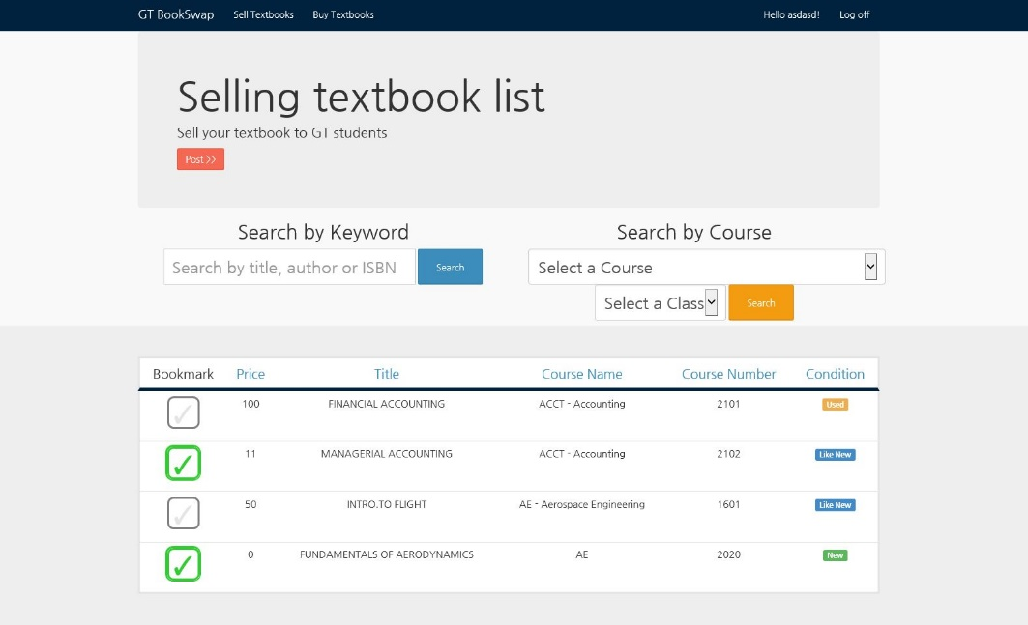
Responsive Web Design(RWD)
Notes:
I am going explain our previous versions what we did before current version. This is our mockup pages which we made before we implement actual coding. At the first time we consider some essential features such as searching by course and bookmarks, so we tried to follow out mockup as possible as we can.
This is our second version of our web site. As we wanted at the first time, we implemented search by course and bookmark hear. And we try to make our website seems to similar with out Georgia tech homepage because we wanted to make our website for Georgia tech’s students as our ultimate goal.
And our final version you will see soon after few min, we added manager pages and we separated between register user and non register user. And the big difffernece between version 2 and final version is we did our website perfectly responsive and we change our overall web site design because we decided that our webpage for gergia student and we combine sellpage and buypage in one page because we wanted to make simple user flow.
이게 두번째 우리의 버전이고 첫번째 버전과 달라진점은 서치를 할때 키워드와 코스로 캐스캐이딩 할 수 있는걸로 나누어져 있는거다 그리고 전체적으로 우리 학교에 맞는 디자인을 적용 하였다. 왜냐면 우리 학교 북스왑 페이지니깐. 자기 글들을 볼수 있는 메니지 창을 추가 하였다. 유저와 비유저를 나누었고 북마크를 추가하였다.
세번째 우리의 버전에서 가장 달라진점은 우선 웹사이트 자체가 리스판시브하다는 것이고 그리고 디자인을 전체적으로 모던하게 바꾸웠다 왜냐하면 웹사이트를 우리학교에만 국한되어 있는 사이트로 만들기 보다는 다른 학교들도 이용할 수 있는 사이트를 만들기 위해서 디자인을 바꾸었고 셀서치 페이지와 바이서치 페이지를 하나로 통합 하였다. 왜냐하면 유저 플로우를 하나로 통합하기 위해서.

Slide 6
Challenge
1. No experience w/ ASP .NET MVC
2. IDE Visual Studio
3. unexpected merging errors.
4. No User data.
5. Work distribution

